Slide 1
Natural Language Processing
University of Karachi
By: Kumail Abbas

Slide 2
NLP Pipeline

Slide 3
Data Acquisition – NLP Pipeline
Public Dataset: We can search for publicly available data as per our problem statement.
Web Scrapping: Web Scrapping is a technique to scrap data from a website. For this, we can use Beautiful Soup to scrape the text data from the web page.
Image to Text: We can also scrap the data from the image files with the help of Optical character recognition (OCR). There is a library Tesseract that uses OCR to convert image to text data.
pdf to Text: We have multiple Python packages to convert the data into text. With the PyPDF2 library, pdf data can be extracted in the .text file.
Data augmentation: if our acquired data is not very sufficient for our problem statement then we can generate fake data from the existing data by Synonym replacement, Back Translation, Bigram flipping, or Adding some noise in data. This technique is known as Data augmentation.

Slide 4
Text Cleaning– NLP Pipeline
Unicode Normalization: if text data may contain symbols, emojis, graphic characters, or special characters. Either we can remove these characters or we can convert this to machine-readable text.
Spelling corrections: When our data is extracted from social media. Spelling mistakes are very common in that case. To overcome this problem we can create a corpus or dictionary of the most common mistype words and replace these common mistakes with the correct word.

Slide 5
Text Preprocessing Pipeline– NLP Pipeline
Tokenization: Tokenization breaks the text into individual words or tokens, creating a list of discrete linguistic units.
Text Normalization: Text normalization includes processes like converting text to lowercase, stemming (reducing words to their base form), and lemmatization (reducing words to their dictionary form).
Stopword Removal: Stopwords are commonly used words (e.g., "the," "and," "is") that are often removed from the text as they do not carry significant meaning.
Sentence Segmentation: In tasks that require sentence-level analysis, text is split into individual sentences.
Part-of-Speech Tagging (POS): POS tagging labels each token with its grammatical category, such as noun, verb, adjective, etc.
Named Entity Recognition (NER): NER identifies and classifies named entities in the text, such as names of people, organizations, locations, etc.

Slide 6
Text Preprocessing Pipeline– NLP Pipeline
Tokenization: Tokenization breaks the text into individual words or tokens, creating a list of discrete linguistic units.
Text Normalization: Text normalization includes processes like converting text to lowercase, stemming (reducing words to their base form), and lemmatization (reducing words to their dictionary form).
Stopword Removal: Stopwords are commonly used words (e.g., "the," "and," "is") that are often removed from the text as they do not carry significant meaning.
Sentence Segmentation: In tasks that require sentence-level analysis, text is split into individual sentences.
Part-of-Speech Tagging (POS): POS tagging labels each token with its grammatical category, such as noun, verb, adjective, etc.
Named Entity Recognition (NER): NER identifies and classifies named entities in the text, such as names of people, organizations, locations, etc.

Slide 7
Feature Engineering - Creating Vectors (Arrays) from Text
In order to process text data, we need to convert it to numbers
We call it Word Embeddings
The most simplest form of Word Embedding techniques:
Bag of Words (BoW)
TF-IDF (Term Frequency – Inverse Document Frequency)
One-hot encoding
Word2Vec is advanced form of embedding technique which use semantics (meaning) from the sentences to form vectors
They are used for feature extraction from text

Slide 8
Bag of Words (BoW)
The Bag of Words (BoW) model is the simplest form of text representation in numbers. Like the term itself, we can represent a sentence as a bag of words vector (a string of numbers).
Let’s consider these three types of movie reviews:
Review 1: This movie is very scary and long
Review 2: This movie is not scary and is slow
Review 3: This movie is spooky and good
We will first build a vocabulary from all the unique words in the above three reviews. The vocabulary consists of these 11 words: ‘This’, ‘movie’, ‘is’, ‘very’, ‘scary’, ‘and’, ‘long’, ‘not’, ‘slow’, ‘spooky’, ‘good’.

Slide 9
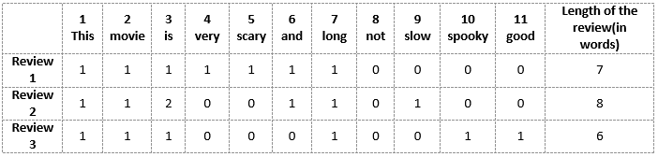
Bag of Words (BoW) – contd.
We can now take each of these words and mark their occurrence in the three movie reviews above with 1s and 0s. This will give us 3 vectors for 3 reviews:
Vector of Review 1: [1 1 1 1 1 1 1 0 0 0 0]
Vector of Review 2: [1 1 2 0 0 1 1 0 1 0 0]
Vector of Review 3: [1 1 1 0 0 0 1 0 0 1 1]
And that’s the core idea behind a Bag of Words (BoW) model.

Slide 10
Drawback of Bag of Words (BoW)
In the last example, we can have vectors of length 11. However, we start facing issues when we come across new sentences:
If the new sentences contain new words, then our vocabulary size would increase and thereby, the length of the vectors would increase too.
Additionally, the vectors would also contain many 0s, thereby resulting in a sparse matrix (which is what we would like to avoid to avoid computation cost)
We are retaining no information on the grammar of the sentences nor on the ordering of the words in the text.

Slide 11
Term Frequency-Inverse Document Frequency (TF-IDF)
Let’s first put a formal definition around TF-IDF. Here’s how Wikipedia puts it:
“Term frequency–inverse document frequency, is a numerical statistic that is intended to reflect how important a word is to a document in a collection or corpus (term used for collection of documents/text).”

Slide 12

Term Frequency (TF)
Let’s first understand Term Frequent (TF). It is a measure of how frequently a term, t, appears in a document, d:

Slide 13
Term Frequency (TF) - Calculation
Review 2: This movie is not scary and is slow
For TF calculation, n is the number of times the term “t” appears in the document “d”.
Thus, each document and term would have its own TF value.
We will again use the same vocabulary we had built in the Bag-of-Words model to show how to calculate the TF for Review #2:
Vocabulary: ‘This’, ‘movie’, ‘is’, ‘very’, ‘scary’, ‘and’, ‘long’, ‘not’, ‘slow’, ‘spooky’, ‘good’
Number of words in Review 2 = 8
TF for the word ‘this’ = (number of times ‘this’ appears in review 2)/(number of terms in review 2) = 1/8

Slide 14
Term Frequency (TF) - Calculation
Review 2: This movie is not scary and is slow
TF(‘movie’) = ?
TF(‘is’) = ?
TF(‘very’) = ?
TF(‘scary’) = ?
TF(‘and’) = ?
TF(‘long’) = ?
TF(‘not’) = ?
TF(‘slow’) = ?
TF( ‘spooky’) = ?
TF(‘good’) = ?

Slide 15
Term Frequency (TF) - Calculation
Review 2: This movie is not scary and is slow
TF(‘movie’) = 1/8
TF(‘is’) = 2/8 = 1/4
TF(‘very’) = 0/8 = 0
TF(‘scary’) = 1/8
TF(‘and’) = 1/8
TF(‘long’) = 0/8 = 0
TF(‘not’) = 1/8
TF(‘slow’) = 1/8
TF( ‘spooky’) = 0/8 = 0
TF(‘good’) = 0/8 = 0

Slide 16
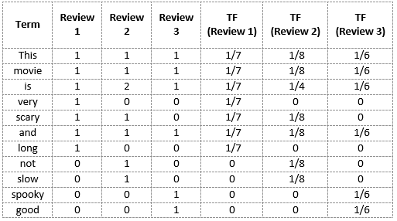
Term Frequency (TF) - Calculation

Slide 17

Inverse Document Frequency (IDF)
IDF is a measure of how important a term is. We need the IDF value because computing just the TF alone is not sufficient to understand the importance of word
We can calculate the IDF values for the all the words in Review 2:
IDF(‘this’) = log(number of documents/number of documents containing the word ‘this’) = log(3/3) = log(1) = 0

Slide 18
Inverse Document Frequency (IDF) - Calculation
Review 2: This movie is not scary and is slow
IDF(‘movie’, ) = ?
IDF(‘is’) = ?
IDF(‘not’) = ?
IDF(‘scary’) = ?
IDF(‘and’) = ?
IDF(‘slow’) = ?

Slide 19
Inverse Document Frequency (IDF) - Calculation
Review 2: This movie is not scary and is slow
IDF(‘movie’, ) = log(3/3) = 0
IDF(‘is’) = log(3/3) = 0
IDF(‘not’) = log(3/1) = log(3) = 0.48
IDF(‘scary’) = log(3/2) = 0.18
IDF(‘and’) = log(3/3) = 0
IDF(‘slow’) = log(3/1) = 0.48

Slide 20
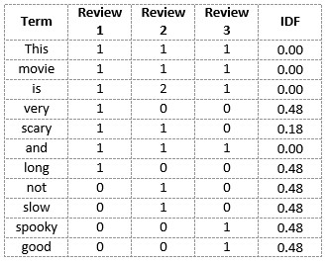
Inverse Document Frequency (IDF) - Calculation
We can calculate the IDF values for each word like this. Thus, the IDF values for the entire vocabulary would be:

Slide 21
Inverse Document Frequency (IDF) - Calculation
Hence, we see that words like “is”, “this”, “and”, etc., are reduced to 0 and have little importance; while words like “scary”, “long”, “good”, etc. are words with more importance and thus have a higher value.
We can now compute the TF-IDF score for each word in the corpus. Words with a higher score are more important, and those with a lower score are less important.

Slide 22

Term Frequencey - Inverse Document Frequency (TF-IDF)
Hence, we see that words like “is”, “this”, “and”, etc., are reduced to 0 and have little importance; while words like “scary”, “long”, “good”, etc. are words with more importance and thus have a higher value.
We can now compute the TF-IDF score for each word in the corpus. Words with a higher score are more important, and those with a lower score are less important.

Slide 23
TF-IDF -> Calculation

Slide 24
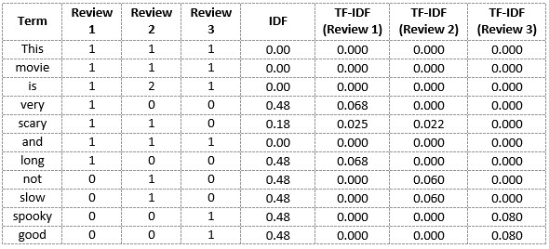
TF-IDF -> Calculation
We have now obtained the TF-IDF scores for our vocabulary. TF-IDF also gives larger values for less frequent words and is high when both IDF and TF values are high i.e the word is rare in all the documents combined but frequent in a single document.

Slide 25
One-Hot Encoding
Let us consider the two sentences
“You can scale your business.”
And
“You can grow your business.”
Vocabulary for these sentences will be: {You, can, scale, grow, your, business}.
A one-hot encoding of these words would create a vector of length 6 (equal to vocabulary length).
The encodings for each of the words would look like this:
You: [1,0,0,0,0,0], Can: [0,1,0,0,0,0], Scale: [0,0,1,0,0,0], Grow: [0,0,0,1,0,0], Your: [0,0,0,0,1,0], Business: [0,0,0,0,0,1]

Slide 26
Word2Vec
Let us consider the two sentences again
“You can scale your business.”
And
“You can grow your business.”
Both the sentences have same meanings but none of previous techniques can incorporate this.
Word2Vec, a word embedding methodology, solves this issue and enables similar words to have similar dimensions and, consequently, helps bring context.

Slide 27
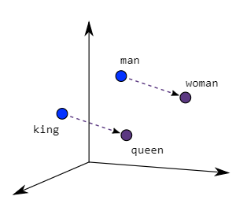
Word2Vec (contd)
As seen in the image below where word embeddings are plotted, similar meaning words are closer in space, indicating their semantic similarity.

Slide 28
Word2Vec (contd)
This implies: king + woman = queen

Slide 29
Word2Vec (contd)
Two different model architectures that can be used by Word2Vec to create the word embeddings are the Continuous Bag of Words (CBOW) model & the Skip-Gram model.
Even though Word2Vec is an unsupervised model where you can give a corpus without any label information and the model can create dense word embeddings, Word2Vec internally leverages a supervised classification model to get these embeddings from the corpus.

Slide 30
Word2Vec (contd)
Two different model architectures that can be used by Word2Vec to create the word embeddings are the Continuous Bag of Words (CBOW) model & the Skip-Gram model.
Even though Word2Vec is an unsupervised model where you can give a corpus without any label information and the model can create dense word embeddings, Word2Vec internally leverages a supervised classification model to get these embeddings from the corpus.

Slide 31
Word2Vec - Continuous Bag of Words (CBOW) model
The CBOW architecture comprises a deep learning classification model in which we take in context words as input, X, and try to predict our target word, Y.
For example, if we consider the sentence – “Word2Vec has a deep learning model working in the backend.”, there can be pairs of context words and target (center) words.
If we consider a context window size of 2, we will have pairs like ([deep, model], learning), ([model, in], working), ([a, learning), deep) etc in format ([input 1,input 2],output). The deep learning model would try to predict these target words based on the context words.

Slide 32
Word2Vec - Skip-Gram model
Considering the same sentence – “Word2Vec has a deep learning model working in the backend.” and a context window size of 2, given the centre word ‘learning’, the model tries to predict [‘deep’, ’model’] and so on.
Since the skip-gram model has to predict multiple words from a single given word, we feed the model pairs of (X, Y) where X is our input and Y is our label. This is done by creating positive input samples and negative input samples.

Slide 33
Word2Vec - Skip-Gram model (contd.)
Considering the same sentence – “Word2Vec has a deep learning model working in the backend.” and a context window size of 2, given the centre word ‘learning’, the model tries to predict [‘deep’, ’model’] and so on.
Positive Input Samples will have the training data in this form: [(target, context),1] where the target is the target or centre word, context represents the surrounding context words, and label 1 indicates if it is a relevant pair.
Negative Input Samples will have the training data in the same form: [(target, random),0]. In this case, instead of the actual surrounding words, randomly selected words are fed in along with the target words with a label of 0 indicating that it’s an irrelevant pair.
In our example: positive sample would be [(leaning,model),1] and negative sample would be [(learning,working),0]

